Slide 1
2D Shape Drawings -
Using logical reasoning to detect and correct errors in algorithms

Slide 2
Today we are learning about…
Logical reasoning and algorithms
I can use logical reasoning to detect and correct errors in an algorithm

Slide 3
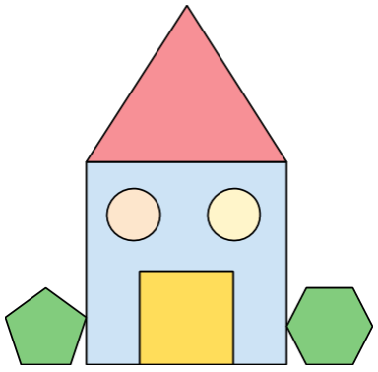
Algorithm for drawing a house
Algorithm | Desired outcome of algorithm
Draw a blue square in the centre of your page Draw an orange equilateral triangle with one edge aligned with the top of the square Draw two blue triangles inside the square Draw a yellow square with sides half the length of the first square, inside the first square Draw a green regular hexagon to the left of the square. The bottom of this shape should be inline with the bottom of the square Draw a purple regular pentagon to the right of the square
All images Pixabay CC0 Public Domain

Slide 4
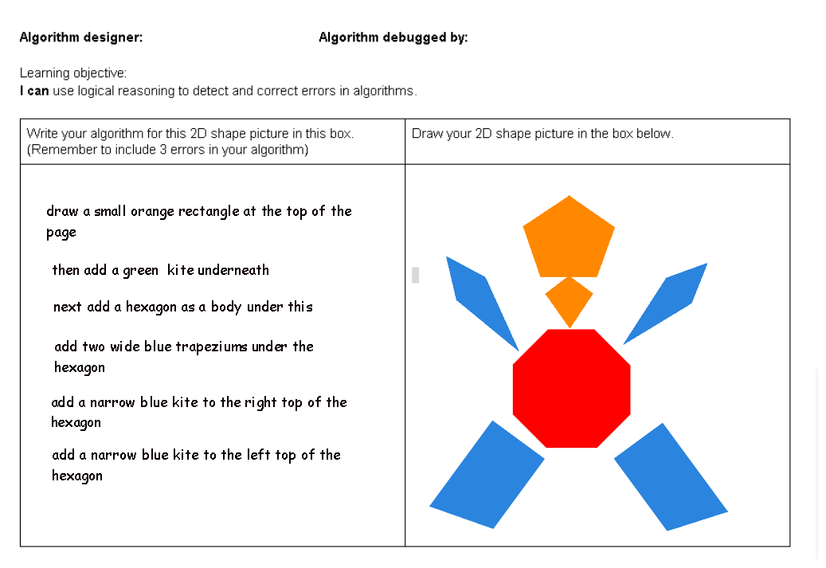
Main task
Task 1 (10 mins)
Fill in a simple drawing made from 2D shapes in the right hand part of the table and write the algorithm for this drawing in the left hand box
Include 3 deliberate mistakes in your algorithm
Task 2 (10 mins)
Sketch out each step of your partners algorithm and use logical reasoning to detect and correct the errors (Identify, Think, Change)
Make changes to the algorithm using a coloured pencil
Extension
Can you spot any patterns in the information needed in each step of the algorithm?

Slide 5
Plenary
Feedback to your partner
Take turns to feedback to your partner the errors you found in their algorithm. For each error, explain:
What error you identified
How you knew it was an error
How you have corrected the error
How you know your correction will work
Did your partner find all the errors you’d purposefully made?
Did they detect and correct any unintentional errors?

Slide 6
Get more

